Slide 1
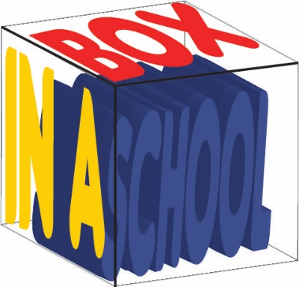
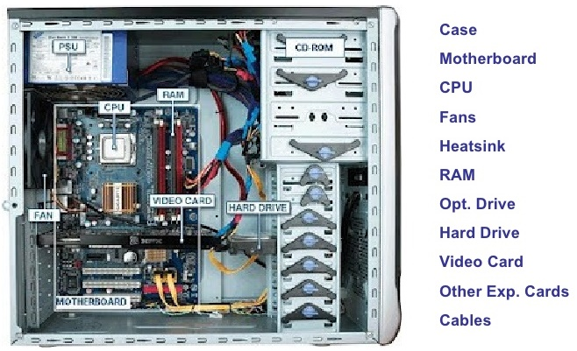
OCR Level 02 – Cambridge Technical
Unit 03 - Building IT Systems
2016 Specification - T/615/1382
LO3 - Be able to select the Components for the Designed IT Systems

Slide 2
Assessment Criteria
The Learner will | Pass The assessment criteria are the pass requirements for this unit. The learner can: | Merit To achieve a merit the evidence must show that, in addition to the pass criteria, the learner is able to: | Distinction To achieve a distinction the evidence must show that, in addition to the pass and merit criteria, the learner is able to:
1. Understand the roles of IT technical support | P1 - Explain the role of an IT support technician in an organisation |  | D1 - Compare the activities of different IT technician roles
2. Be able to design IT systems to meet business needs | P2: Propose an IT system to meet specified business needs | M1 -Justify how the design meets the specified business needs
3. Be able to select the components for the designed IT systems | P3 - Select the hardware components for the proposed IT system | M2 - Justify why the selected components meet the proposed Specification
 | P4 - Select the software for the proposed IT system
4. Be able to build and configure IT systems to meet business needs | P5 - Build and test the IT system | M3 - Carry out acceptance testing with the client | D2 - Evaluate the results from testing and recommend improvements
 | P6 - Configure and test the IT system

Slide 3
LO3 - Aim and Purpose
Learning Outcome 3: Be able to select the components for the designed IT systems.
Your task is to: select the appropriate hardware and software components that will be required to build the IT system proposed in Task 2.
The SMT of Progress Academy has now agreed your proposal and has instructed you to develop the proposed IT system.
You will now need to select the appropriate hardware and software components required to meet the requirements of the IT system you proposed in Task 2.
The SMT of Progress Academy will be reviewing your selection of hardware and software and so you must clearly explain why you have selected each component.

Slide 4
Assessment Criterion P3, P4, M2
P3.1 - Hardware Components, i.e.:
internal system unit components, e.g.:
Processor, motherboard, internal memory, expansion cards, storage devices
computer form factors, e.g.:
Laptops, desktops, all-in-ones.
handheld devices, e.g.:
tablets
handheld terminals
mobile phones
Peripherals, i.e.
output devices, e.g.:
display devices, e.g.:
flat screen, touch screen, projector
printer, e.g.:
Laser, inkjet, thermal, 3D
speakers
input devices, e.g.:
pointing devices, e.g.:
Mouse, joystick, touchpad, keyboard, microphone
P3.2 - Network Requirements
network equipment, i.e.:
router
cabling, e.g. Fibre, Twisted Pair, Coaxial
server, e.g. Internet, File, Mail
hub
switch
wireless adapters
types, e.g.:
LAN, WAN, PAN
Topologies, e.g.:
Mesh, Ring, Bus, Star
P4.1 - Software Components, i.e.:
operating system, e.g.:
Windows, Linux, Mac, Google
Productivity Software, e.g.:
word processing
spreadsheet software
email software
database software
presentation software
Collaboration Software, e.g.:
document storage/sharing
email software
video conferencing software
Utility Software, e.g.:
Software Firewalls
Anti-Malware
M2.1 - Justification (how does it meet business requirements), e.g.:
purpose
viability
intended users
cost
hardware and software equipment
security
recovery

Slide 5
Assessment Criterion P3, P4, M2
P3 - Learners are required to select the hardware components identified in P2. Evidence could include photographs of the hardware selected and linked to the component list.
P4 - Learners are required to select the software components identified in P2. Evidence could include photographs of the software or URL where they are to be downloaded from.
M2 - Learners are required to justify how selected components meet the proposed specification from P2. This must relate to particular business requirements as stated in the scenario. Evidence can be in the form of a report or presentation with speaker notes.
Why do teachers do registers each lesson What happens if my attendance drops below 95%. Who will know? What Management System does my school have Can I see my own grades How much data is automated and how much needs to be typed.

Slide 6
Assignment Scenario
In order for any organisation to run effectively and successfully achieve its targets a range of supporting systems will need to be used.
It is now common practice that the vital systems within an organisation are automated and computer controlled which promotes accuracy and efficiency.
This has resulted in the increasing need for IT support technicians who are responsible for the design, development, implementation and testing of those systems. The role of an IT support technician requires an enhanced level of knowledge about hardware, software and networks and is now a vital role within most organisations.
Progress Academy – IT support systems
Progress Academy is an education establishment with 500 students. The current systems in the academy are paper-based but the Academy would like to reduce the errors and environmental impact of paper-based systems through the use of automation.
The subsequent use of computer controlled systems will not only have a positive environmental impact but should improve the speed and accuracy at which the systems operate.
The Academy has identified three priority systems that require immediate automation - the student registration system, the monitoring of student grades and the control of stock and resources in the Academy e.g. paper, pens and equipment.

Slide 7
Assignment Scenario
There are also secondary systems which are considered important to the effective daily running of the Academy. These include fault reporting, financial management and building maintenance routines.
The SMT at the Academy has very little experience with the design and implementation of IT systems and so has recently employed an IT support technician who will be responsible for the design and building of the IT support systems within it.
Progress Academy – IT system specification
Progress Academy has stated the priority requirements that their IT system must have. These include:
printing documentation and scanning documents or images;
storing up to 500GB of information and images;
transferring data to hand held devices, e.g. tablets or laptops;
specialist display devices where appropriate;
hosting video conferencing;
a simple and easy to use graphical user interface;
networking functionality to enable files transfer and sharing;
a range of suitable software applications appropriate for teaching staff and students;
internet access including appropriate security measures;
authorised user only access;
appropriate backup and recovery systems.

Slide 8
P3.1 – Internal System Unit Components
There are 3 users for these three systems and all three kinds of users require different hardware for their part of the overall purchase. Teachers for instance will not need access to the order tracking but will for the Student Grades and Registration.
A technician will need access to all 3 systems, a secretary for the student registration and order tracking only. For all three staff members you will need to specify the different hardware necessary for their roles. Evidence could include photographs of the hardware selected and linked to the component list.
For the following tasks you should create a list of the necessary hardware needed for each function by each of the staff and users.
This can be done as a report or in a table but for the Merit criteria you will need to justify the cost, viability etc. so it would be better as a written report.
Why do teachers do registers each lesson What happens if my attendance drops below 95%. Who will know? What Management System does my school have Can I see my own grades How much data is automated and how much needs to be typed.

Slide 9
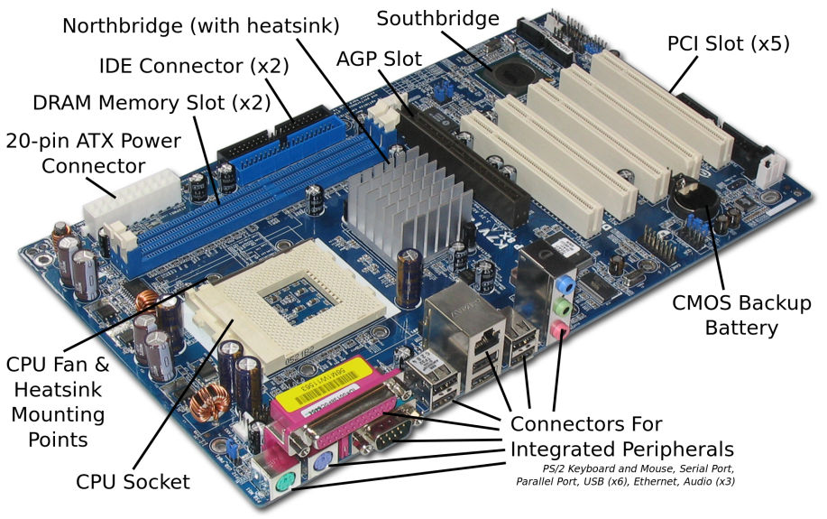
P3.1 – Internal System Unit Components
There are 8 main parts of a computer
Motherboard – This is the main component inside all computers and is a base for all the other components to connect to. It is complimented by the CPU. There are lots of technical things about Motherboards you could look up such as Bridges, Models, Connectors and Speed.
All processes link through the Motherboard which holds the memory (RAM and ROM) to move information to and from the CPU.
Though they look complex, most motherboards are set up in a similar way.
What is in the box in front of you Why some computers are slower than others Why a tablet has a different look and feel to a laptop. The USB memory stick you, how does the computer know it is there. What will be different in terms of hardware in ten years. Will a tablet replace a Laptop
Motherboard | CPU | Video Card | RAM
Power Supply | Hard Disk | Optical Drive | BIOS

Slide 10
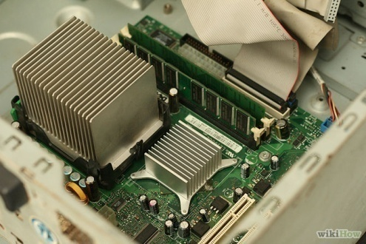
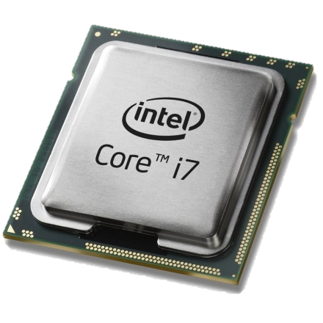
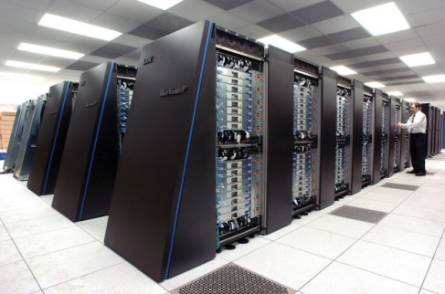
P3.1 – Internal System Unit Components
CPU – This is the brain of the computer whereas the motherboard is the heart. This does all the thinking (Processing) and takes information from the inputs (Keyboards, mouse, scanner etc.), processes the information (thinks about the commands given and reproduces them into binary instructional codes) and then outputs the processing to the output devices (screen, printer, GPU)
The rule is: The faster the CPU, the faster the machine can process instructions. This is why it is the most expensive component within the computer and the most important.
There are different kinds, Intel with its Core and Xeon range, Celeron and AMD are the 3 main manufacturers.
All computers, mainframes, tablets and phones have one of these at the heart of the machine.

Slide 11
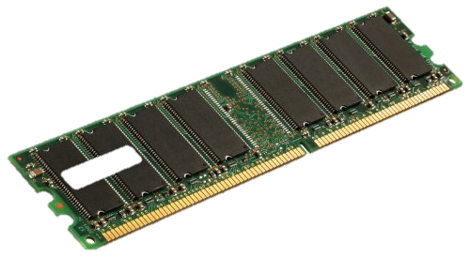
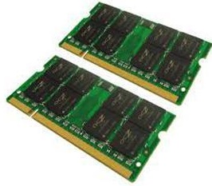
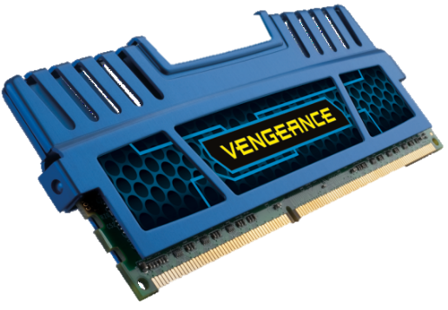
P3.1 – Internal System Unit Components
RAM (Random Access Memory) – There have been a few developments in Ram over the decades and most of this is down to size and speed. Ram size is measures in 128 or 256mb chunks and can be DDR1, DDR2 or DDR3 (3 being more expensive but faster), and the rule is the more memory a machine has, the faster it can store and process information.
They have a clock speed, the faster the clock speed, the faster the processing time. And this improves games, the more processing power that is taken from the CPU, the faster the CPU can deal with the instruction code of the game.
Unlike some hardware ram can be upgraded, simply remove the smaller one with a larger one but machines are limited to how many sockets there are for RAM.
Ram controls the CPU output and input, information is stored onto the Ram for processing and back from the CPU to Ram for dealing with and anything that helps the CPU is good. For Laptops the Ram is physically smaller but works in the same way.
People often mistake RAM with storage but RAM has no moving parts and does not overheat or break easily.

Slide 12
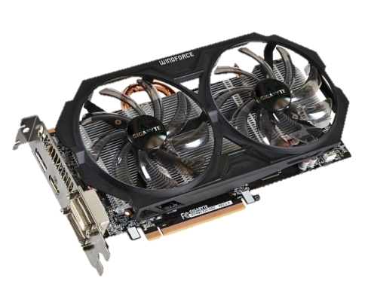
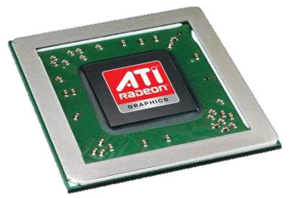
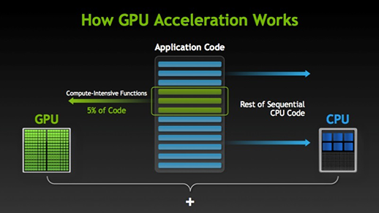
P3.1 – Internal System Unit Components
Video Graphics cards handle all of the visual data within a computer, interpret it and display it via a VDU. Components on a Graphics card include:
GPU – Graphical Processing Unit is a dedicated microprocessor making calculations in order to display both 2D and 3D graphics.
Motherboard interface – This is the method of connection and transfer of information between the motherboard. These include PCI, AGP and PCI express.
Video BIOS - basic program that governs the video card's operations and provides the instructions that allow the computer and software to interface with the card.
Video memory – if the card is integrated onto the mother board it may use the computers RAM, otherwise it will have a dedicated amount of memory for use for storing other data as well as the screen image such as object co-ordinates.
Random Access Memory Digital-to-Analogue Converter – This coverts the digital signals produced by the computer processor into an analog signal which can be understood by the computer display
Output connectors – this is how the graphics card connectors to the VDU. This can include DVI, HDMI and component.
Cooling device – Video cards may use a lot of electricity, which is converted into heat. If the heat isn't dissipated, the video card could overheat and be damaged. Cooling devices are incorporated to transfer the heat elsewhere. Three common methods are heat sink, fan or water block.

Slide 13
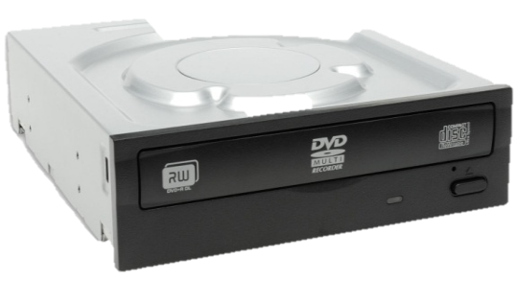
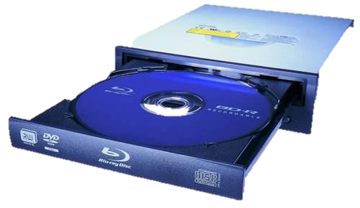
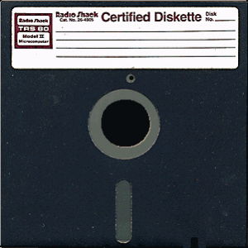
P3.1 – Internal System Unit Components
Optical Drive - First there was CD, 700MB, then DVD, 4400MB, now Blu-Ray. These are still not enough to back up a network drive but they are very useful as timed backups. All systems except Thin Client come with these as standard, they run off the IDE cable to the motherboard and act like a separate hard drive, taking a drive letter. Only certain Drives are RW, rewritable, but disks are so cheap that most people do not bother. This is a big step from the 3.5” and the 5.25” drives that were prevalent until 1999.
Optical media – These are more common now for network storage, capable of saving 120gb on one drive for a complete backup, takes an hour on a standard network to copy down to, can be carried away, and then reused, deleted like a memory stick and resaved.
Network managers tend to use these as a medium because of their reliability, set it running, leave it, take it away when done. Sizes of these vary again with price. They are not as easily accessible for home use like memory sticks or USB because they take time to archive and search.

Slide 14
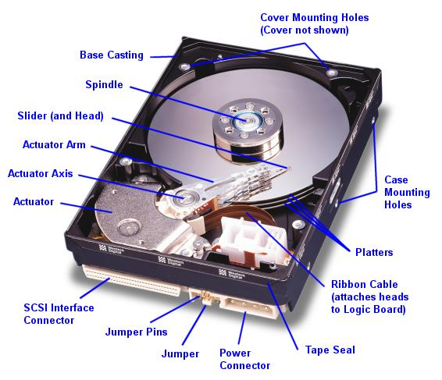
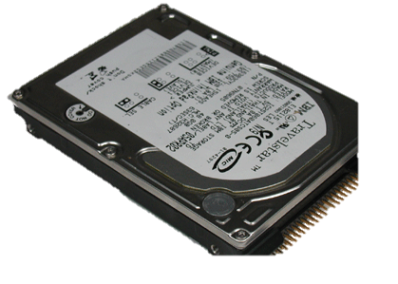
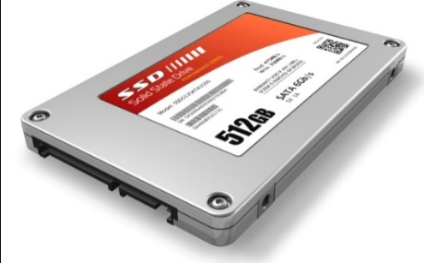
P3.1 – Internal System Unit Components
Hard Disk - There are two sizes of hard drive for a PC, 2.5” for a laptop and 3.5” for a full machine. This has been the de facto standard since PC’s first came out. The original PC hard drive on home computers were a massive 20mb. But with operating systems starting at MS Dos 3, all you needed was 2mb for operating system storage. Word processors were 4mb, spreadsheets another 1mb leaving a massive 13mb for games and file storage. Doom, the most popular PC game ever, installed onto 5mb and could only run off the hard drive. So you played Doom or you played something else. These all used an IDE standard, the same connectors on the PC for linking up the Hard Drive to the motherboard.
Speed differentiation came into play, hard drive speeds of 5300 rpm, increased to 7200 rpm, and hard drives grew in size exponentially. 80mb became 120, then 200, 320, 500 and then a massive 10gb by 2000. Now the standard hard drive with a new PC is 250gb but 1.5 terabyte ones are available for home use at affordable prices. The faster the hard drive, the quicker the loading speed. For games this meant installing huge numbers of games on one machine at a time.
The new standard is SATA which is faster than IDE and easier to install allowing the use the daisy chain multiple drives onto a PC.

Slide 15
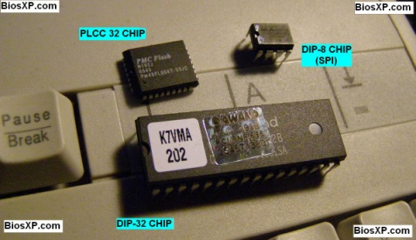
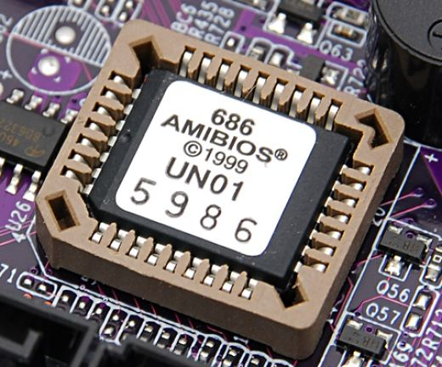
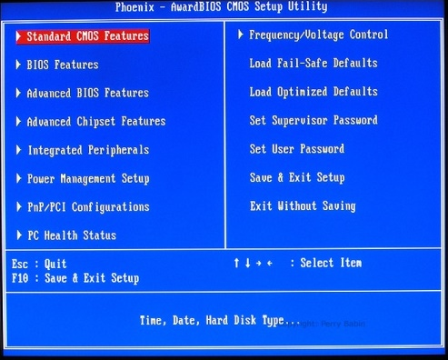
P3.1 – Internal System Unit Components
BIOS – Built in operating system is a small battery linked to the core of the motherboard that tells a computer what it is, what CPU, what hard drives, what kind of motherboard, where the connectors are, what time of day it is and what standard devices are connected on the inside like Hard Drives and CD’s. All computers have one but they seem the least of things.
The two most common types are Phoenix and Ami, they contain a battery life of at least 3 years and contain several pages of important information, specifically hard drive configurations and IRQ allocation. Operating systems can override the BIOS but this takes extra time and can lead to IRQ conflicts.
P3.1 – Task 01 – For the three proposal needs, outline and explain the Internal System Unit Components necessary to meet the school’s ICT purpose.

Slide 16
P3.2 – Computer Form Factors
There are many different types of computer in existence, we will focus on the most common ones.
PC – A PC/Desktop usually refers to a general purpose computer which is made up of separate monitor, keyboard and mouse and processing unit (Base) The term PC comes refers to a system which is IBM compatible, rather than Apple and sometimes gets confused with a Laptop.
Advantages – Spare parts and connections tend to be standard reducing the price.
Desktops have to be a better specification (e.g. faster processor) for a given price (often due to size and construction restraints of a laptop)
The large case allows for heat dissipation.
Disadvantages – They are not portable since they are made up of separate components.
All the components need to be hooked up with wiring, which can be quite complex and clutters up the desk space.
Because they are not portable, it is necessary to copy files when you want to do work elsewhere.
Better and bigger screens Can have multiple internal hard drives. Only need to change one thing to make it faster. Playing games Desk space (footprint). Noise levels Clutter, cables, leads, inputs and outputs. Not environmentally friendly when disposing of.

Slide 17
P3.2 – Computer Form Factors
Laptops (or Notebooks) – This refers to a range of computers where the monitor, keyboard, pointing device and processor are all together in one unit, making them more portable.
These have become the most common type of Computer in the home but not at work. Most companies prefer their staff not to be away from their desks. Over the decades of use, they have grown more powerful and in some ways smaller with better battery life.
Advantages – Portable since all the devices are combined.
Low Weight (to aid portability)
Low power consumption (therefor longer battery life)
A processor that does not generate too much heat (cooling is vital)
Good for sampling and sensoring.
Disadvantages – Since they are portable, they are easy to steal.
Limited battery life so the user has to carry a power supply.
Keyboards and pointing devices can be difficult to use.
Heat dissipation is more difficult due to the structure of the laptop.
Graphics on the screen will not be as good as a standalone. (e.g. Motion blur)
Restricted on the amount of devices that can be added at one time.
Which one you would prefer and why. The limitations in game playing or TV watching. How many you have broken by accident. Spills and how expensive it will be to repair compared to a PC. Desk space (footprint). Noise levels Lack of clutter, cables, leads, inputs and outputs.

Slide 18
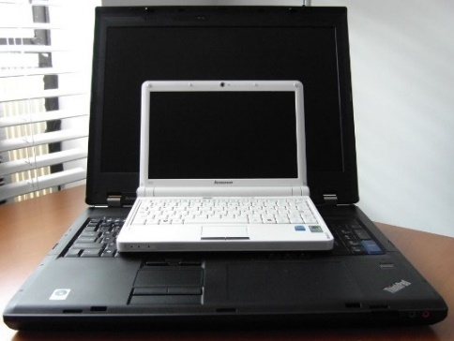
P3.2 – Computer Form Factors
Netbook – This is a term used to describe a computer that can almost fit into your hand and is a smaller version of a Laptop. They used to be knows as Palmtop computers but this term now generally applies to much smaller devices which use touch screens and often a stylus to key in data.
Advantages – They have many of the features of Laptops therefor have similar advantages.
They are more portable and use less battery life die to their limited functionality.
Tend to have no moving parts (therefor better battery usage).
Disadvantages – They do not have optical drives (CD, DVD) which makes installing difficult.
The keyboards are only about 80% the size of Laptop keyboards.
They lack some of the features found in larger machines, principally due to the size constraints.
Cheaper to purchase due to their limited capacity.
Small and easy to put away Comparison to tablets. How a school could use them in a class. Smaller screen so more difficult to read. Desk space (footprint). Noise levels Lack of clutter, cables, leads, inputs and outputs. Screen displays web pages in a similar way to a computer and not a tablet.

Slide 19
P3.2 – Computer Form Factors
All-In-Ones – These are computers that have all the components built into the one shape, all within the monitor, usually with the DVD drive vertical, thin so the hard drives are smaller in size (not in capacity) and take up a lot less room than a standard PC. Over the years these have become thinner and larger making them good for an office environment.
Advantages – Footprint (amount of desk space they take up)
Less wiring needed (less risk of tripping)
Easier to disconnect and move.
Convenience in accessing USB sockets.
Disadvantages – Harder to repair individual problems due to the complex nature of their build.
Easier and often more likely to steal.
Harder to upgrade (the components inside are designed to fit into a small area so replacing or upgrading a part for a physically larger part is more difficult).
P3.2 – Task 02 - For the three proposal needs, outline and explain the Computer Form Factors necessary to meet the school’s ICT purpose.
The popularity of the iMAC’s How easy it is to rotate and move them. How good a suite of these would look in your school. Sometimes the power button is difficult to get to. Desk space (footprint). Noise levels Lack of clutter, cables, leads, inputs and outputs. Where the heat comes out of the machines.

Slide 20
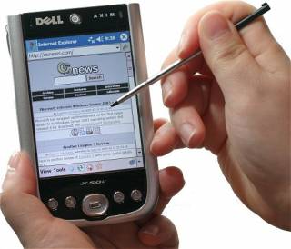
P3.3 – Handheld Devices
Handheld Terminals and PDA’s – These are small handheld computers that usually come with a touch screen that is activated using a stylus. Data (e.g. text) is entered by using a keyboard that appears on the touch screen. Originally these devices were used as personal organisers but their use has expanded to include new generation mobile phones, data loggers, satellite navigation systems (GPS), personal fitness measures etc. Many PDA’s now have a basic database, word-processing and spreadsheet facilities.
Advantages – They can be used anywhere because of their size.
They are very lightweight and more portable than laptop computers.
They can be used to sign for packages because of the stylus design.
They can have GPS or RFID tracking to measure the delivery time of drivers.
Disadvantages – It is difficult to enter text quickly.
They have very limited capabilities due to the software and the operating system used.
Small and easy to put away Comparison to tablets. How a school could use them in a class. Smaller screen so more difficult to read. Desk space (footprint). Noise levels Lack of clutter, cables, leads, inputs and outputs. Screen displays web pages in a similar way to a computer and not a tablet.

Slide 21
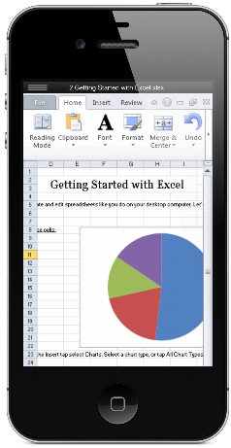
P3.3 – Handheld Devices
Mobile Phones – These are small handheld devices with more limited capacity than Tablets but are very similar in that they usually come with a touch screen that is activated using fingers. Data (e.g. text) is entered by using a pop up keyboard that appears on the touch screen only.
With the massive increase in their popularity, they are more convenient and easier for younger users, their portability, ease of use and ability to have a wide range of applications and connectivity, makes them very useful outdoors but limited and distracting in the classroom.
Advantages – They can be used anywhere because of their size.
They are very lightweight and more portable than tablet systems.
Everyone has one and batteries can last longer (chargers).
Sending information from them can be through Bluetooth, Wi-Fi, cloud or USB.
Disadvantages – It is difficult to enter text quickly.
They have very limited capabilities due to the software and the operating system used.
They are easier to steal and break.
Storage capacity is limited.
Distracting
Small and easy to put away Comparison to PDA’s. How a school could use them in a class. Smaller screen so more difficult to read. Desk space (footprint). Noise levels Lack of clutter, cables, leads, inputs and outputs. Displaying web pages can involve left and right scrolling or pinching.

Slide 22
P3.3 – Handheld Devices
Tablets – These are small handheld computers that usually come with a touch screen that is activated using a stylus or fingers. Data (e.g. text) is entered by using a pop up keyboard that appears on the touch screen or can have a keyboard connected to make them into a netbook.
With the massive increase in their popularity, they are more convenient and easier for younger users, their portability, ease of use and ability to have a wide range of applications and connectivity, makes them very useful in classrooms.
Advantages – They can be used anywhere because of their size.
They are very lightweight and more portable than laptop computers.
Apps can be locked into the device for classroom use.
Sending information from them can be through Bluetooth, Wi-Fi or cloud (or USB on some).
Disadvantages – It is difficult to enter text quickly.
They have very limited capabilities due to the software and the operating system used.
They are easier to steal and break.
Storage capacity is limited.
P3.3 – Task 03 – For the three proposal needs, outline and explain the Handheld Device Components necessary to meet the school’s ICT purpose.
Small and easy to put away Comparison to PDA’s. How a school could use them in a class. Smaller screen so more difficult to read. Desk space (footprint). Noise levels Lack of clutter, cables, leads, inputs and outputs. Displaying web pages can involve left and right scrolling or pinching.

Slide 23
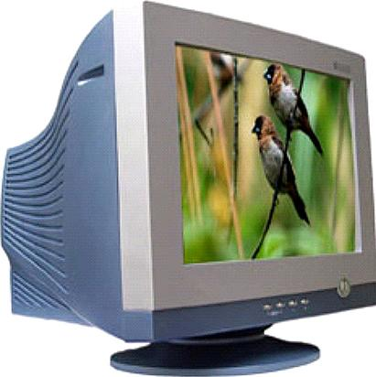
P3.4 – Peripherals – Output Devices
Output devices are hardware devices those that allow data to be output. Some hold information temporarily like printers whereas others have a permanent output in the form of a hard copy.
CRT Monitors – These are the least expensive monitor and becoming more rare as TFT is taking over. They come in various sizes and use an electron gun to fire against a phosphor screen which creates a picture made up of small dots either Red, Green or Blue.
Uses – They are used as the primary output of base computers so the user can see what they are typing in.
They are used with Light Pens to allow designs to be created on screen.
Advantages – They still produce a higher quality image than TFT monitors.
The angle of viewing is still better than a TFT monitor.
They work with Light Pens in CAD/CAM applications.
Disadvantages – They tend to be heavy and often a weigh hazard.
If they are older, they run hot due to gathered dust on the metal plates.
They use more power than any other monitor
They can flicker, which causes headaches and eyesight problems with prolonged use.
The average 24” one can weight 6 stone. The screen is curved, TFT’s are flat, why? Are there any left in your school? All energy causes heat, feel how hot the top of the monitor is. They do not have a cable that disconnects like TFT. Desk space Footprint?

Slide 24
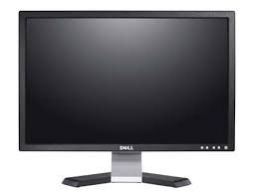
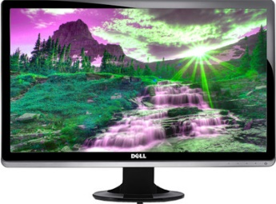
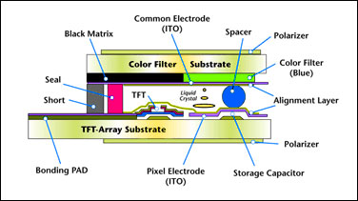
P3.4 – Peripherals – Output Devices
TFT Monitors – They are replacing CRT’s as the standard main output device. Laptop development is because of the advancement in the technology of TFT’s. The screen is made up of thousands of tiny pixels which are transistors controlled by a microprocessor. Each pixel has 3 transistors, Red, green and Blue, the intensity of each is what is seen.
Uses – They are the primary output device to see what is being typed.
They are an integrated part of a Laptop.
Advantages – They are lightweight so they are less risky than CRT’s
They produce less glare and emit less radiation, use less power and generate less heat.
Disadvantages – The angle of viewing is critical, the image is unclear when viewed from the side which is an issue when more than one person is looking at it.
The definition is not as good as CRT’s.
They cannot be used by light pens reducing down their CAD ability.
Why you would still prefer a TFT than a CRT Modern ones that have the computer build into the display like an iMac. Why some people have more than 1 display. Why do they hide the buttons on the right hand side. If you could project your tablet to one without cables, would you want one.

Slide 25
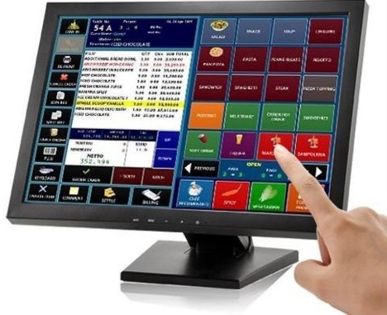
P3.4 – Peripherals – Output Devices
Touch Screen Monitors – These are usually flat screen monitors with the added feature that instead of only using the mouse, the screen can be interacted with in a similar way as a table or phone, but they are larger and useful for icon selection, specifically for people with mobility issues..
They are often integrated into new Laptops that act as a dual purpose of laptop and disconnected screen for a tablet.
Advantages – They are easier to use for selection purposes so they are less risky than CRT’s.
They produce less glare and emit less radiation, use less power and generate less heat.
Good for mobility issues and demonstration purposes.
Disadvantages – The angle of viewing is critical, the image is unclear when viewed from the side which is an issue when more than one person is looking at it.
The definition is not as good as CRT’s.
Over a period of time they can get dirty, smudged and can be easier to damage than a CRT screen if pressed too hard.
Why you would still prefer a TFT than a CRT Modern ones that have the computer build into the display like an iMac. Why some people have more than 1 display. Why do they hide the buttons on the right hand side. If you could project your tablet to one without cables, would you want one.

Slide 26
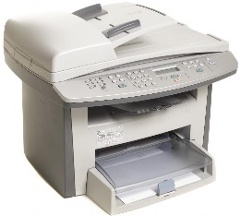
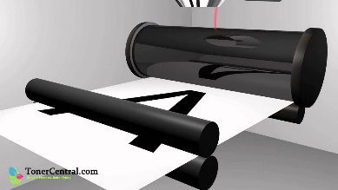
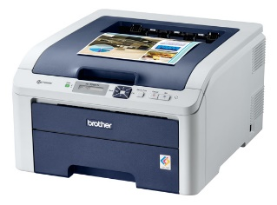
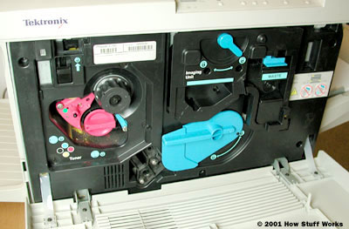
P3.4 – Peripherals – Output Devices
Laser Printer produce very high quality hard copy output. The print rate per page is very quick for large print jobs. They have large buffer memories where the data for the whole document is stored before the data is printed out.
Uses – Laser printers are used where noise levels need to be kept low.
They are the best option for fast high quality volume printing
Advantages – Printing is fast for bulk, but not for just a few pages.
They require less servicing and ink replacement as they print a lot more pages making them more cost effective for B&W printing.
They handle very large print jobs due to high memory capacity with consistent high quality.
Disadvantages – They are more expensive to buy. Colour versions are very expensive to buy and run since they require 4 cartridges as well as diffuser kits and toner bins.
Why are there so many old looking ones in the room? Can you repair a paper jam. Does anyone ever use the built in menu. What if there was a par ton top for quick copying. Why are they always square. Did you know that the toner ink is very toxic?

Slide 27
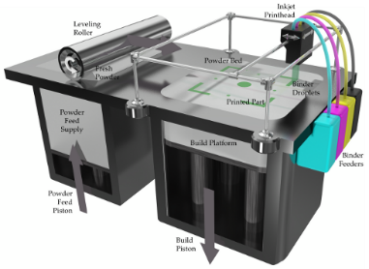
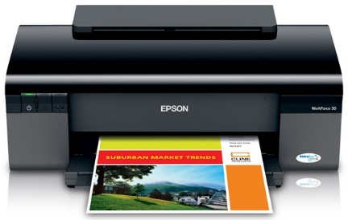
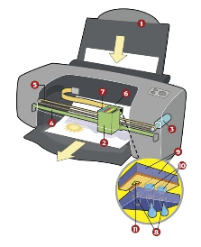
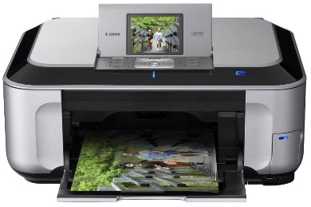
P3.4 – Peripherals – Output Devices
Inkjet printers are used to produce good quality hard copies, usually in colour. They are not as good as laser printers but are far better than dot matrix. They do not have large memory buffers so printing is done a bit at a time, causing the print job to pause and think and get more data.
Uses – They are used when there is low volume required or if colour is required or good quality single jobs like Photo printing.
3D inkjet printers are now being used in industry producing prototypes.
Advantages – The output is high quality and are cheaper to buy than laser printers.
They are light with a small footprint.
They do not produce ozone and volatile organic compounds unlike laser printers.
Disadvantages – The output is slow for multiple copies and they have a small memory buffer for jobs.
Ink cartridges run out quickly and can smudge if the user is not careful.
New versions have wi-fi, card slots and screens Lots of moving parts and small paper trays When one ink runs out you can replace it easily. Most people get a laser and do away with the inkjet, why? Sometimes they cost less than the printer cartridge so it is cheaper to get a new one when the ink runs out.

Slide 28
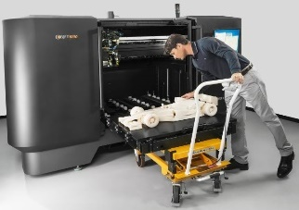
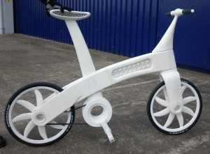
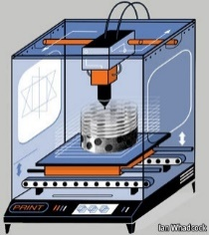
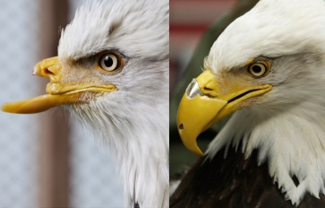
P3.4 – Peripherals – Output Devices
3D Printers are anew type of printer that can produce 3D models using modified inkjet technology, known as “tomography” which layers thin levels of powder (plaster, resin and starch) which bonds together as a 3D model as the layer builds up, each layer being about 0.25mm thick.
Uses – Inkjet printers are use to produce prototypes which work from CAD packages, photograph images and stored drawings.
Scale models are produced in colour before the real versions are manufactured.
The ultimate objective is to produce organic objects using layering like human organs.
Advantages – They save a lot of money since prototypes is very time consuming by other methods.
Physical scale models are produced with working parts which gives a better idea of how the end product will look.
The powders used can be ground up and reused.
Disadvantages – They are expensive to buy and slow at making models.
The end product can be a little rough and often needs additional work.
Think of what can be produced now and then image 10 years time. They are working on food versions. They flew one to the MIR space station recently. Google the term Physibles. One day they will print a working car. Research is fast developing, human tissue is not far off, they have printed veins.

Slide 29
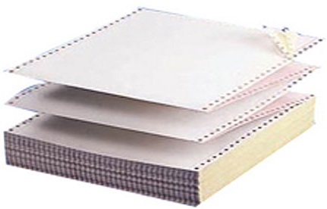
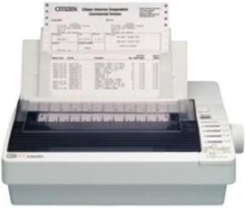
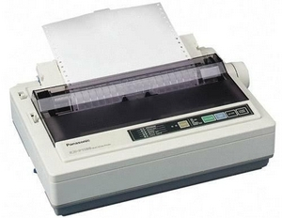
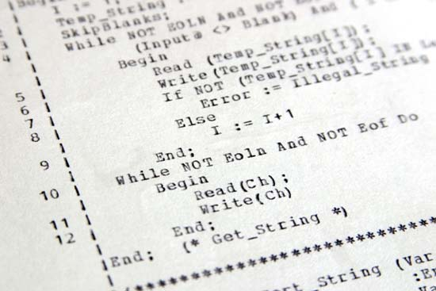
P3.4 – Peripherals – Output Devices
Dot Matrix Printers are a type of impact printer where a print head (made up of a matrix of pins) presses against an inked ribbon. They tend to be slow, noisy and the output is not good quality. They are still useful where multi-part or continuous stationery, perforated paper is used.
Uses – They can be used in noisy environments (e.g. garage workshops) and in applications where print quality is not important.
Advantages – They are used in environments which would be a problem for Laser or Inkjet printers (dusty, dirty or moist)
Carbon copies or multi-part outputs can be produced.
They are cheap to run and maintain.
They are easy to use if continuous stationery is required like wage slips.
Disadvantages – They are very noisy and not good in an office space.
They cost more than an inkjet to buy.
They are slow and the quality is poor.
Some companies put them in a sound box Every printer was different so the ribbons were not universal. It was possible to turn the ribbon over on some. Paper jams were so much worse. They had no complicated menus, just 3 buttons. They were always white or cream.

Slide 30
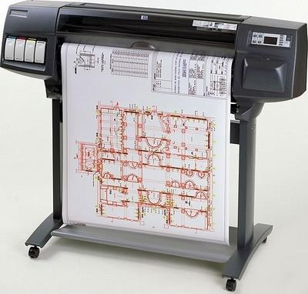
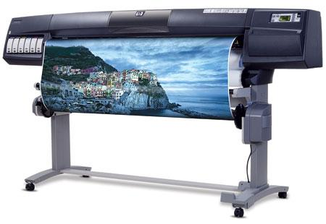
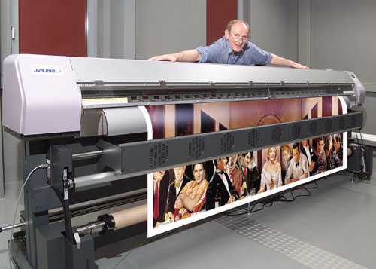
P3.4 – Peripherals – Output Devices
Plotters or Graph Plotters are devices that produce hard copies but differently than printers. They are not limited to normal paper sizes and are capable of producing highly accurate, very large drawings and posters. Pen plotters are the most common which use coloured pens to draw, and there are electrostatic (similar to laser) and inkjet plotters. With pen plotters the coloured pens backwards and forwards to allow accurate shapes to be drawn.
Uses – They are used to produce large blueprints of buildings, factories etc. and re controlled by the computer and the paper can move often used with CAD packages.
They are used for billboards and large posters and can print on plastic coated paper.
If the pens are replaced with cutting tools then they can be used as stencils or to make large signs.
Advantages – They produce large printouts and the quality is very high.
Disadvantages – They are slow and expensive to but and maintain.
Before these architects used to hand drawn large designs. Some are very large, large enough to walk under. More common now to save the file and print it professionally. Think of a large poster and then think wall size large. Very rare to see them but in business they are more common.

Slide 31
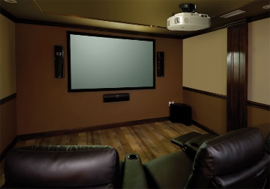
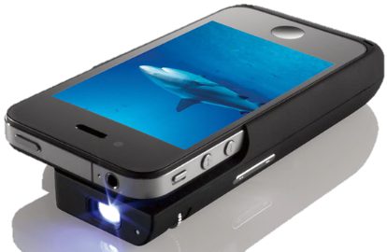
P3.4 – Peripherals – Output Devices
Multimedia projectors receive analog or digital signals, usually from a computer TV or DVD player. The image from the source is magnified and projected onto a large screen. They usually have a remote control, but a virtual mouse is becoming popular with new ones.
Uses – They are used for training presentations to show to a large audience.
They are also used for advertising presentations at exhibitions, shopping malls etc.
Home cinema systems using projected DVD’s
Advantages – They enable larger audiences than a screen or TV
Used in classes to watch videos or PPT’s rather than a network.
Disadvantages – Images are sometimes fuzzy.
They are expensive to buy and difficult to set up in terms of space.
Would you like one for the bedroom to watch TV on. Very similar technology to film projectors. There will be a device for your phone that can do the same. Research Keystone. Requires a darker room than normal to view the images. Watch almost any movie and spot them being used..

Slide 32
P3.4 – Peripherals – Output Devices
Speakers can be connected directly to a computer or built into the monitor or casing like a laptop. Digital data from the computer is converted into analogue form using a Digital to Analog Converter (DAC) and then amplified through the speaker.
Uses – They output sound from multimedia presentations, home entertainment centres and downloaded sound files.
They can help blind people (together with speech generated software) to through audio output of the text on the screen.
Advantages – They are better quality externally than laptop speakers.
There have been advance in 5.1 and 7.1 technology.
Disadvantages – They take up desk space and give off a magnetic field which can corrupt cards and disks.
P3.4 – Task 04 – For the three proposal needs, outline and explain the Output Devices necessary to meet the school’s ICT purpose.
Have you tried to sue an external speaker on your phone or computer. With music computers these are essential when it comes to quality. There are some very large speakers. The larger they are, the more need for an amplifier. They can be customised to blend in with the furniture.

Slide 33
P3.5 – Peripherals – Input Devices
Input Devices – As the name suggests, input devices are hardware devices that allow data to be input into a computer. Many such devices exist, ranging from the more common ones such as Keyboards, through to the more specialist ones, such as Barcode Readers.
Keyboards – These are the most common input devices and are used to input text, numbers and instructions into the computer. Most use the QWERTY layout. (Top row)
Ergonomic Keyboards are a new thing. They are designed to reduce health related issues associated with the standard keyboard (e.g. Carpal Tunnel Syndrome or repetitive strain injury RSI)
102 keys plus shortcuts +shift options. All the keyboard shortcuts you know already. How a laptop keyboard is the same but smaller. The keypad on the right hand side, who uses it. Look at ergonomic keyboards and see if you think you could use them. What alternative could you use.

Slide 34
P3.5 – Peripherals – Input Devices
Advantages – Keyboards enable fast entry of new text into a document.
They have been around for a long time and people are well practiced in their use.
It is easy to do verification checks as data is entered, as it appears on the screen immediately.
Disadvantages – User with restricted arm/wrist use can find keyboards difficult to use
Entering data using a keyboard is slow in comparison to direct data entry (Optical Character Recognition)
Keyboards are fairly large devices that take up desk space.
102 keys plus shortcuts +shift options. All the keyboard shortcuts you know already. How a laptop keyboard is the same but smaller. The keypad on the right hand side, who uses it. Look at ergonomic keyboards and see if you think you could use them. What alternative could you use.

Slide 35
P3.5 – Peripherals – Input Devices
A Numeric Keypad is used to enter numbers only along with the most common mathematical functions.
Uses – Numeric Keypads are used in Automatic Teller Machines (ATM’s) where customers can key in their personal identification number (PIN), an amount of money etc.
Telephones have Numeric Keypads to allow phone numbers to be entered.
Electronic Point of Sales (EPOS) terminals have Numeric Keypads in case the barcode reader fails to read and the number has to be typed in manually.
Chip and PIN devices have Numeric Keypads for PIN entry, amount of money etc.
They are used by accountants to fast entry the input of numbers into spreadsheets and ledgers.
Advantages – Numeric Keypads are faster than standard keyboards for entry of numeric data
Since many are on small devices (mobile phones, PIN readers etc.) they are very easy to carry around.
Disadvantages – They can be difficult to use since they have small keys.
It is difficult to use them for entering text.
Sometimes the order of the numbers on the keypad isn’t intuitive.
102 keys plus shortcuts +shift options. All the keyboard shortcuts you know already. How a laptop keyboard is the same but smaller. The keypad on the right hand side, who uses it. Look at ergonomic keyboards and see if you think you could use them. What alternative could you use.

Slide 36
P3.5 – Peripherals – Input Devices
The Mouse is an example of a pointing device. A ball or laser light is used underneath the mouse to detect movement so the user can control the position of the cursor by moving it.
There are usually 2 buttons which have different functions: very often left button is used to select something and the right button to open up an options dialog box.
Most packages use double click to select areas or triple click to select a larger area.
Many mice also have a scroll button or wheel which speeds up the process of moving or scrolling through a document.
Recent developments have produced the optical mouse (where movement is detected by reflected light) and the cordless mouse (an example of a wireless device). The advantage of an optical mouse is that it has no moving parts and does not pick up dirt making it more robust and improves its performance since the older mice could skid on certain surfaces.
Before a mouse there was a tracker ball, what is it. Look at how hard core gamers use their mice. Can you use a touch screen faster than a mouse. New 3D programs use pinch and 3D rotate, could a mouse do this. Could you design an alternative mouse. When Apple Mice had one button..

Slide 37
P3.5 – Peripherals – Input Devices
Uses – Mice can be used for opening, closing and minimizing applications.
They can be used for grouping, moving and deleting files.
They are very useful when editing images, for example controlling the size and position of a drawing pasted into a document.
Mice are used to control the position of a cursor on the screen to allow the selection from a menu or selecting an icon.
Advantages – It can be faster to select an option using a mouse than with a keyboard,
Mice enable rapid navigation through applications and the internet.
Mice are small and take up little area.
Disadvantages – people with restricted hand/wrist movement can find it hard to operate a mouse.
Mice are easily damaged and the older ones can get clogged up with dirt.
They are difficult to use if there is no flat surface readily available.
Before a mouse there was a tracker ball, what is it. Look at how hard core gamers use their mice. Can you use a touch screen faster than a mouse. New 3D programs use pinch and 3D rotate, could a mouse do this. Could you design an alternative mouse. When Apple Mice had one button..

Slide 38
P3.5 – Peripherals – Input Devices
Touchpads are used in many laptops as a pointing device. The pointer is controlled by finger movement on the pad and tapping to simulate a left button mouse click. They also have buttons under at the bottom of the pad which act as left and right mouse buttons.
Uses – The same as a mouse, to move and highlight.
Advantages – Faster to select an option rather than using a mouse
Quicker navigation through applications and the Internet.
Since they are built in to a laptop, there is no need for an external mouse, aiding portability.
They can be used even when there are no flat surfaces.
Disadvantages – People with limited hand/wrist movement find touchpads difficult to use.
It can be more difficult to control a pointer compared to a mouse.
They are more difficult for certain functions like “drag and drop.”
Can use Pinch to zoom in and out. No moving parts so they do not get internally dirty. More and more common in laptops. Think of how you could add a second one to a laptop for shortcuts. Could you design an alternative touchpad. All the tech is underneath so they rarely break..

Slide 39
P3.5 – Peripherals – Input Devices
Trackerballs are similar to a mouse except the ball is on the top of it and the user controls the pointer on the screen by rotating it with the hand. Some have 2 buttons which have the same function as a mouse. If they have a third button it is the equivalent as a double click.
Uses – They have the same pointing/cursor control as a mouse.
They are used in applications where the user has is restricted like RSI.
They are used in control room environments where it is faster than a mouse to navigate through process screens and is more robust than a mouse.
Advantages – They do not need the same fine control as a mouse.
People with limited hand/wrist movement find it easier than a mouse.
They take up less desk space than a mouse because they are stationary.
Disadvantages – They are not supplied with the computer as standard so they are more expensive.
Users may need training since they are not standard.
Cannot pinch with them Not restricted to working at a desk with some of them. Combined with tilt they are good for gaming. Means one hand has to be by the device Very similar to joystick controls Think of large surface machines and the use of Trackerballs.

Slide 40
P3.5 – Peripherals – Input Devices
Joysticks have similar functionality to mice and Trackerballs. By gripping the stick, a pointer on the screen can be controlled and buttons are used to make selections. Often they have another button on the top that is used for gaming purposes e.g. to fire a weapon.
Uses – Video/Computer Gaming are usually controlled by a joystick
They are used for simulators, such as flight, to mimic actual controls.
Advantages – It is easier to navigate around a screen using a joystick than a keyboard.
Control is in 3 dimensions.
Disadvantages – It is more difficult to control the on-screen pointer with a joystick than with other devices such as a mouse.
Useful for flight controls Has a full 360 degree tilt and swivel. Can be removed from the desk. Difference between left and right handed. Otften used with secondary device or stick. Use of Yaw, Pitch and Roll.

Slide 41
P3.5 – Peripherals – Input Devices
Touch Screens – With this the user can choose an option by simply touching the button/icon on the screen. The selection is automatically made without the need for any pointing device.
Uses – Used for Self-Service tills e.g. ATM’s, Supermarkets, EPOS, Airports or petrol stations, where the user just touches the screen to make a choice like fuel and payment method.
PDA’s, Smart phones, and Sat-Navs.
Interactive whiteboards are large touch screens.
Computer based training (CBT) where touch screens are used to select answers.
Advantages – Faster entry of options than a keyboard or mouse.
User friendly and no training necessary.
Tamper proof to prevent keying in information that is not wanted, e.g. unmanned ticket booths.
Disadvantages – There is a limited number of options available.
Using them frequently can lead to RSI and muscle strain.
They get dirty easily from constant touching.
Can use Pinch to zoom in and out. No moving parts so they do not get internally dirty. More common in modern devices. Technology is getting better. Sensitivity can be changed for disability access. All the tech is underneath so they rarely break. The bigger they are, the more delicate they are.

Slide 42
P3.5 – Peripherals – Input Devices
Scanner are used to enter information on hard copy (text documents, photographs, pages of a book) into a computer for manipulation. The common type is flat bed which is made up of a glass panel and lid. The hard copy document is scanned by a light source and produces a computer readable image for manipulation using a drawing package, or OCR (Optical Character Recognition) so it can be placed in a word processing, DTP or Presentation package. Some scanners are more specific like a barcode or optical mark reader.
Uses – Used to scan in documents and covert them to a usable format.
Old and valuable books can be scanned, thus protecting the originals from damage or producing records of paper copies.
Non-digital photographs need to be scanned if they are to be stored on computer.
Advantages – Images can be stored for editing.
Much faster and more accurate, no typing errors, than typing.
It is possible to recover lost documents and photos by scanning them.
Disadvantages – The quality can be limited, depending on the scanner and will never be as good as the original quality.
Used to be a common desktop piece of hardware everyone had There is an App for that. 3D scanners are becoming more popular. Think of how a 3D scanner and 3D printer could be combined. Document scanners can do 100 pages or more at a time.

Slide 43
P3.5 – Peripherals – Input Devices
Microphones can be connected directly to the computer. Sounds can be inputted and then manipulated. The input sound is converted to an analogue signal and then converted to a digital signal. The computers sound card does this automatically (ADC).
Uses – They are used to input speech/sounds to be used in various applications e.g. presentations, film and music sampling, special effects.
They are used in voice recognition software which have a number of purposes:
Conversion of speech into text for use in a word processor.
Recognition of commands like voice activated cars or Siri.
Advantages – It is faster to read in text than to type it with a keyboard.
Using specialist manipulation software it is possible to edit sounds in real time instead of using live studio techniques.
If used in voice activation then it is more secure than passwords also reducing the need for drivers to remove their hands from steering.
Disadvantages – Sound files take up computer space and memory.
Voice recognition software is not as accurate as typing manually (think of words like there and their and they’re)
P3.5 – Task 05 – For the three proposal needs, outline and explain the Input Devices necessary to meet the school’s ICT purpose..
How you could use a voice dictation program. Voice quality on cheap mics when skyping. How they are integrated to laptops but not PC’s. The people who talk to the earphone cable in the street. How your earphones are also microphones if you plug them into the other socket.

Slide 44
P3.6 – Network Equipment
On top of the hardware and software necessary to manage the 3 school tasks so that the software running on the hardware can connect effectively, be managed remotely and passively and problem areas can be reduced.
For this task you will need to describe the Functions and Uses of the following network hardware and structures and justify their use within the school management project.
Network equipment, i.e.:
router
cabling, e.g. Fibre, Twisted Pair, Coaxial
server, e.g. Internet, File, Mail
hub
switch
wireless adapters
Types, e.g.:
LAN, WAN, PAN
Topologies, e.g.:
Mesh, Ring, Bus, Star

Slide 45
P3.6 – Network Equipment
Hubs are hardware devices that can have a number of devices or computers connected to them. They are often used to connect together a number of devices to form a LAN – e.g. a star network.
Its main task is to take any data packet (this is a group of data being transmitted) received at one of its ports and broadcast to every computer in the network. This essentially means that using a hub is not a very secure of efficient method of data distribution.

Slide 46
P3.6 – Network Equipment
Switches are similar to hubs but are much more efficient in the way that they distribute data packets. As with hubs, they connect a number of devices or computers together to form a LAN.
However, unlike a hub, the switch checks the data packet received and works out its destination address (or addresses) and sends the data to the appropriate computer(s) only, This makes using a switch a more secure way of distributing data.
Each device or computer on a network has a media access control (MAC) address that uniquely identifies it. Data packets sent to switches will have a MAC address identifying the source of the data and additional addresses identifying each device that should receive the data (see 4.1.2 for more on MAC addresses).

Slide 47
P3.6 – Network Equipment
Bridges are devices that connect one LAN to another LAN that uses the same protocol (communication rules). They are often used to connect together different parts of LAN so that they can function as a single LAN.
Bridges tend to be used to interconnected LAN’s (or parts of LAN’s) since sending out every data packet to all possible destinations would quickly flood larger networks with unnecessary traffic. For this reason a router is used to communicate with other networks, such as the internet.
Server
Computer
Computer
Computer
HUB/SWITCH
HUB/SWITCH
Computer
Computer
Computer
BRIDGE

Slide 48
P3.6 – Network Equipment
Routers enable data packets to be routed between the different networks, e.g. to join a LAN to a wide area network (WAN). A router would typically have an internet cable plugged into it and several cables connecting to computers and other devices on the LAN.
Figure above shows how routers work.
Computer
Server
Computer
HUB/SWITCH
ROUTER
Computer
LAN
Internet

Slide 49
P3.6 – Network Equipment
Broadband routers sit behind a firewall. The firewall protects the computers on a network. The router’s main function is to transmit internet and transmission protocols between two networks and also allow private networks to be connected together.
Routers inspect the data packets (see next slide) sent to it from any computer on any of the networks connected to it. Since every computer on the same network has the same part of an internet protocol (IP) address, the router is able to send the data packet to the appropriate switch and it will then be delivered using the MAC destination address (see 4.1.2). If the MAC address doesn’t match any device on the network, it passes on to another switch on the same network until the appropriate device is found.

Slide 50
P3.6 – Network Equipment - Servers
Servers are basically computers set aside for a single network purpose. For this task you will need to example just tree types: Internet, File and Mail Servers.
Mail Server
A mail server is a server that handles the network’s e-mail needs. It is configured with e-mail server software, such as Microsoft Exchange Server. Exchange Server is designed to work with Microsoft Outlook, the e-mail client software that comes with Microsoft Office. Most mail servers actually do much more than just send and receive electronic mail. For example, here are some of the features that Exchange Server offers beyond simple e-mail:
Collaboration features that simplify the management of collaborative projects.
Audio and video conferencing.
Chat rooms and instant messaging (IM) services.
Microsoft Exchange Forms Designer, which lets you develop customized forms for applications, such as vacation requests or purchase orders.

Slide 51
P3.6 – Network Equipment - Servers
File servers
File servers provide centralized disk storage that can be conveniently shared by client computers on the network. The most common task of a file server is to store shared files and programs. For example, the members of a small workgroup can use disk space on a file server to store their Microsoft Office documents.
File servers must ensure that two users don’t try to update the same file at the same time. The file servers do this by locking a file while a user updates the file so that other users can’t access the file until the first user finishes.
For document files (for example, word-processing or spreadsheet files), the whole file is locked. For database files, the lock can be applied just to the portion of the file that contains the record or records being updated.
File Server
Mail Server
Web Server

Slide 52
P3.6 – Network Equipment - Servers
Internet (Web) Server
A Web server is a server computer that runs software that enables the computer to host an Internet or Intranet Web site. The two most popular Web server programs are Microsoft’s IIS (Internet Information Services) and Apache, an open-source Web server managed by the Apache Software Foundation.
These often store copies of commonly used Web pages in a local cache. When a user requests a Web page from a remote Web server, the proxy server intercepts the request and checks to see whether it already has a copy of the page in its cache. If so, the Web proxy returns the page directly to the user. If not, the proxy passes the request on to the real server.
File Server
Mail Server
Web Server

Slide 53
P3.6 – Network Equipment
Both Wi-Fi and Bluetooth offer wireless communication between devices. They both use radio frequencies as the carrier of data transmission.
How Computers use Wi-Fi and Bluetooth to connect to Networks
Wi-Fi
A wireless transmitter (WAP) receives information from a network via its connection (e.g. a broadband connection if the internet is used). This transmitter converts the received information into radio waves and then transmits them.
A device (e.g. a computer) receives the radio waves via an installed wireless adaptor which allows it to download the information from the data source. This, of course, works in reverse when the device wishes to transmit data over the network.
Wi-Fi is best suited to operating full-scale networks since it offers much faster data transfer rates, better range and better security than Bluetooth. A Wi-Fi-enabled device (such as a computer or smartphone) can access, for example, the internet wirelessly at any access point (AP) of hot spot up to 100M away.
Or Click here

Slide 54
P3.6 – Network Equipment
Bluetooth
Bluetooth sends and receives radio waves in a band of 79 different frequencies (known as channels). These are all centered on a 2.45GHz frequency.
Devices using Bluetooth automatically detect and connect to each other, but they don’t interfere with other devices since each communicating pair uses a different channel (from the 79 options)
When a device wants to communicate, it picks one of the 79 channels at random. If the channel is already being used, it randomly picks another channel. This is known as spread-spectrum frequency hopping.
To further minimise the risk of interference with other devices, the communication pairs constantly change the frequencies (channels) they are using (several times a second).
Or Click here

Slide 55
P3.6 – Network Equipment
Essentially, Bluetooth is useful:
When transferring data between two or more devices that are very close together (<30m distance)
When the speed of data transmission is not critical
For low bandwidth applications (e.g. when sending music files from a mobile-phone to a headset)
Bluetooth creates a secure wireless personal area network (WPAN) based on key encryption.
Table below summarises some of the differences between Wi-Fi and Bluetooth.
Feature | Bluetooth | Wi-Fi
Transmission frequency used | 2.4GHz | 2.4, 3.6, 5.0GHz
Data transfer rate (maximum) | 25 Mbits/second (3.1 Mbytes/second) | 250 Mbits/second (-31 Mbytes/Second)
Maximum effective range (metres) | 30M | 100m (but can be obstructed by walls etc. reducing effective range to only a few metres)
Maximum number of devices connected | Up to 7 | Depends on the router used (can be one or many devices)
Type of data transmission security | Key matching encryption | WEP (wireless equivalent privacy) and WPA (Wi-Fi protected access) are the most common security systems.

Slide 56
P3.6 – Network Equipment - Cabling
Wireless mobile technology
A wireless network is a network that uses radio signals rather than direct cable connections to exchange information. A computer with a wireless network connection is like a mobile phone. Just as you don’t have to be connected to a phone line to use a mobile phone, you don’t have to be connected to a network cable to use a wireless networked computer.
A wireless network is often referred to as a WLAN, for wireless local area network. The term Wi-Fi is often used to describe wireless networks, although it technically refers to just one form of wireless networks: the 802.11b standard.
Wireless networks can transmit over any of several channels. In order for computers to talk to each other, they must be configured to transmit on the same channel. The simplest type of wireless network consists of two or more computers with wireless network adapters. Either way, they require a wireless adapter installed on each device.

Slide 57
P3.6 – Network Equipment - Cabling
Coaxial Cable - You can construct an Ethernet network by using one of two different types of cable: coaxial cable, which resembles TV cable, or twisted-pair cable, which looks like phone cable. Twisted-pair cable is sometimes called UTP, or 10BaseT cable.
This type of cable that was once popular for Ethernet networks is coaxial cable, sometimes called thinnet or BNC cable because of the type of connectors used on each end of the cable. Thinnet cable operates only at 10Mbps and is rarely used for new networks. However, you’ll find plenty of existing thinnet networks still being used.
You may encounter other types of cable in an existing network: thick yellow cable that used to be the only type of cable used for Ethernet, fibre-optic cables that span long distances at high speeds, or thick twisted-pair bundles that carry multiple sets of twisted-pair cable between wiring closets in a large building. For all but the largest networks, the choice is between coaxial cable and twisted-pair cable.
Twisted-pair cable - The most popular type of cable today is twisted-pair cable, or UTP (Unshielded Twisted Pair). UTP cable is even cheaper than thin coaxial cable, and best of all, many modern buildings are already wired with twisted-pair cable because this type of wiring is often used with modern phone systems.

Slide 58
P3.6 – Network Equipment - Cabling
Fibre optic
Fibre Optic is called 10BaseFX. Because fibre-optic cable is expensive and tricky to install, it isn’t used much for individual computers in a network.
However, it’s commonly used as a network backbone. For example, a fibre backbone is often used to connect individual workgroup hubs to routers and servers.
Fibre-optic networks also require NICs. Fibre-optic NICs are still too expensive for desktop use in most networks. Instead, they’re used for high-speed backbones.
If a server connects to a high-speed fibre backbone, it will need a fibre-optic NIC that matches the fibre-optic cable being used.
P3.6 – Task 06 – For the three proposal needs, outline and explain the Network hardware and Devices necessary to meet the school’s ICT purpose..

Slide 59
P3.7 – Network Types – LAN, WAN, PAN
Local Area Networks (LAN’s) and Wide Area Networks (WAN’s), Local Area Networks (LAN’s), Personal Area Network (PAN)
These systems are usually within one building, or certainly not very far from each other geographically. A typical LAN will consist of a number of computers and devices (e.g. printers) that are connected to hubs or switches.
One of the hubs or switches will usually be connected to a router and a modem (usually broadband) to allow the LAN to connect to the internet; in doing so it then becomes part of a WAN.

Slide 60
P3.7 – Network Types – LAN, WAN, PAN
Advantages
The sharing of resources (such as expensive peripherals and applications software)
Ease of communication between users.
A network administrator to control and monitor all aspects of the network (e.g. changing passwords, monitoring internet use etc.)
Disadvantages
Easier spread of viruses throughout the whole network.
Printer queues developing, which can be frustrating.
Slower access to external network, such as the internet.
Increased security when compared to stand-alone computers.
If the main server breaks down, in most cases the network will no longer function.

Slide 61
P3.7 – Network Types – LAN, WAN, PAN
Wide Are Networks (WAN’s) are used where computers or networks are situated a long distance from each other geographically (e.g. in a different city or country). If a number of LAN’s are joined together using a router or modem, then they can form a WAN. The most common examples of WAN include the Internet and the network of ATM;s (automated teller machines) used by banks.
Because of the long distances between devices, WAN’s usually make use of some public communications networks (such as telephone lines or satellites) but they can use dedicated or leased communication lines which can be less expensive and also ,more secure (less risk of hacking).
A typical WAN will consist of end systems and intermediate systems (see right).
1, 3, 7 and 10 and known as end systems and the remainder are known as intermediate systems. The distance between each system can be considerable, especially if the WAN is run by a multinational company.
7
1
4
8
2
5
9
3
6
10

Slide 62
P3.7 – Network Types – LAN, WAN, PAN
Wireless LAN’s (WLAN’s) are similar to LAN’s but there are no wires or cables. In other words, they provide wireless network communications over fairly short distances (a few metres) using radio or infrared signals instead of cables.
Devices, known as access points (AP’s) or wireless nodes are connected into the wired network at fixed locations. Because of the limited range, most commercial LAN’s (e.g. at a college campus or at an airport) need several AP’s to permit uninterrupted wireless communications. The AP’s use either spread spectrum technology (which is a wideband radio frequency with a range of about 30-50m) or infrared (which has a very short range, about 1-2m, and is easily blocked; it therefor has a limited use).
The AP receives and transmits the data between the WLAN and the wired network structure. End-users access the WLAN through wireless LAN adapters that are built into the devices or are a plug-in module.

Slide 63
P3.7 – Network Types – LAN, WAN, PAN
Advantages
All computers can access the same servers and resources (such as printers, scanners, internet access) from anywhere within the range of the AP’s.
As there is no cabling there is a safety improvement and increased flexibility (since the user no longer has to remain at their desk).
Click Here
Adding new computers and devices is very easy (all that is required is a WLAN adapter) and the costs are reduced since extra cabling isn’t needed.
Disadvantages
Security can be a big issue since anyone with a WLAN-enabled laptop can access a network if it can pick up a signal; it is therefor necessary to adopt complex data encryption techniques.
There may be a problem with interference, which can affect the signal.
The data transfer rate is slower than in a wired LAN.

Slide 64
P3.7 – Network Types – LAN, WAN, PAN
Personal area network (PAN)
A PAN is a computer network for interconnecting devices centered on an individual person's workspace. A PAN provides data transmission amongst devices such as computers, smartphones, tablets and personal digital assistants.
PANs can be used for communication amongst the personal devices themselves, or for connecting to a higher level network and the Internet (an uplink) where one master device takes up the role as gateway. A PAN may be carried over wired computer buses such as USB.
A wireless personal area network (WPAN) is a low-powered PAN carried over a short-distance wireless network technology such as IrDA, Wireless USB, Bluetooth and ZigBee. The reach of a WPAN varies from a few centimeters to a few meters.
Think about how you can set up your Smartphone as a Mobile Hotspot, this is a low level form of PAN.
P3.7 – Task 07 – For the three proposal needs, outline and explain the Network Types available to meet the school’s ICT purpose..

Slide 65
P3.8 – Network Topologies - Star
There are different ways networks can be set up depending on space, money, what is already in place, size of room, speed etc. These are called topologies.
There are 4 kinds you need to discuss in your report on setting up the 3 student management systems.
Star Topology
A star topology is a network set out in the shape of a star, branching from one central fibre to the outliers.
A star topology is designed with each node (file server, workstations, and peripherals) connected directly to a central network hub, switch, or concentrator.
Data on a star network passes through the hub, switch, or concentrator before continuing to its destination. The hub, switch, or concentrator manages and controls all functions of the network. It also acts as a repeater for the data flow.
This configuration is common with twisted pair cable; however, it can also be used with coaxial cable or fiber optic cable.

Slide 66
P3.8 – Network Topologies - Star
Advantages of a Star Topology
Easy to install and wire.
No disruptions to the network when connecting or removing devices.
Easy to detect faults and to remove parts.
Disadvantages of a Star Topology
Requires more cable length than a linear topology.
If the hub, switch, or concentrator fails, nodes attached are disabled.
More expensive than linear bus topologies because of the cost of the hubs, etc.
Or Click Here

Slide 67
P3.8 – Network Topologies - Mesh
Mesh Topology
Mesh Network is a network where all the nodes are connected to each other and is a complete network. In a Mesh Network every node is connected to other nodes on the network through hops. Some are connected through single hops and some may be connected with more than one hope.
While the data is travelling on the Mesh Network it is automatically configured to reach the destination by taking the shortest route which means the least number of hops. Data travels by hopping from one node to another and then reaches the destination node in a Mesh Topology Network.
The advantage of a mesh topology is that if one cable breaks, the network can use an alternative route to deliver its packets.
Mesh networks are not very practical in a LAN setting. For example, to network eight computers in a mesh topology, each computer would have to have seven network interface cards, and 28 cables would be required to connect each computer to the seven other computers in the network. Obviously, this scheme isn’t very scalable.

Slide 68
P3.8 – Network Topologies - Mesh
Mesh Topology
However, mesh networks are common for metropolitan or wide area networks. These networks use devices called routers to route packets from network to network. For reliability and performance reasons, routers are usually arranged in a way that provides multiple paths between any two nodes on the network in a mesh-like arrangement.
The Mesh Network is based on a very sensible concept and has lesser chances of a network breakdown. There are so many possible combinations of routes and hops a data transfer can take that it will reach the destination one way or the other. It is highly unlikely that all the nodes in a single Mesh Network will break down at any given point of time.

Slide 69
P3.8 – Network Topologies - Ring
Ring Topology
A Ring Topology network is a localised network joined by a central line that forms a loop. Information can find its way around the loop in either direction as long as there is an unbroken line.
Computers can be joined to the loop through T junctions of drop cables as can additional devices.
This makes everything localised and is usually formed on a single room or bank of computers. The smaller the ring, the quicker information can pass to the relevant point. This also allows computers to act as individual servers like an email server or print server.

Slide 70
P3.8 – Network Topologies - Ring
Advantages of a Ring Network
Information can flow both ways around the ring in order to reach its goal. One of the easier networks to set up and easy to add additional devices to. System is localised so there is less cabling.
Disadvantages of a Ring Network
Loop needs to be completed or terminated at one end. A break in the cable brings the whole thing down. File server needs to be localised or the ring joined to the trunk line.

Slide 71
P3.8 – Network Topologies - Bus
Bus Topology
A linear bus topology consists of a main run of cable with a terminator at each end. All nodes (file server, workstations, and peripherals) are connected to the linear cable.
Using T junctions, more machines and peripherals can be added to the main line of cable. Information is sent down the cable to the router if the cable is long, or the server is the system is short where the information is dealt with.
This relies heavily on the speed and function of the main trunk line.
Similar to a real bus, information can step off along the line when it reaches its destination or can continue to the server (main depot) where it then gets sent back down the line to its destination like a print job coming out of a printer.

Slide 72
P3.8 – Network Topologies - Bus
Advantages of a Linear Bus Topology
Easy to connect a computer or peripheral to a linear bus.
Requires less cable length than a star topology.
Disadvantages of a Linear Bus Topology
Entire network shuts down if there is a break in the main cable.
Terminators are required at both ends of the backbone cable.
Difficult to identify the problem if the entire network shuts down.
Not meant to be used as a stand-alone solution in a large building.
P3.8 – Task 08 – For the three proposal needs, outline and explain the Network Topologies available to meet the school’s ICT purpose..

Slide 73
P4.1 – Software Components - OS
From the moment you switch on a computer, you are accessing the OS of the machine, PC’s have them, phones, laptops, tablets, they all have an operating system that gives the user the ability do operate and access programs. But there are different types, each with their own benefits and issues. But they all perform the same tasks.
Windows – This will be the one you are most used to, a standard menu system for accessing icons and programs on a PC or Laptop. You will be used to it, WIMP interface, Control Panels, altering settings and installing hardware.
Linux – This is a free rival to Windows and operates the same way but has more modifications and versions. The user can create and adapt what is there for their own purpose making it open-source. WIMP interface and installed primarily on PC’s and Laptops and Network Servers.
Mac – Also called OSX and different versions over the years, WIMP like Windows, but operates primarily on Apple computers and Laptops.
Google – Also knows as Android, installed and run on Tablets and Phones, very popular and free OS. Icon generated interface with tough screen, upgradeable and adaptable.
P4.1 – Task 09 – For the three proposal needs, outline and explain the Operating Systems available and explain how they can be used to meet the school’s ICT purpose.

Slide 74
P4.2 – Software Components - Productivity
Productivity Software is the standard, cross platform compatible programs that all companies use to some degree to satisfy business functions. The five common types are:
Word processing – Reports, books, homeworks, letters to parents, school writing work, this is one of the most common purposes of having a computer.
Spreadsheet software – Used for formulas, charts and calculations, can also be used for tracking and grade analysis, uses cells, rows and columns to lay out information is a table formal.
Email software – From Messenger to full email inclusion within the email server, this program catalogues, filters and distributes emails, stores them in folders and pre-fetches addresses.
Database software – This type deals with large amounts of data into simple to read interfaces, from full school management systems to simpler access files. Involves customising an interface to make it easier for the user.
Presentation software – Demonstrates information is an easier to digest form, either as a presentation or a flash file ,locked or unlocked, can use templates and customised house styles.
P4.2 – Task 10 – For the three proposal needs, outline and explain the Software Components available and explain how they can be used to meet the school’s ICT purpose.

Slide 75
P4.3 – Software Components - Collaboration
In addition to standard software, most schools and businesses also use Collaboration Software in order to share files and workloads. For instance a student database needs to be shared among all teaching staff but restricted functions will exist. For this task you will need to discuss in context of the scenario the following:
Document storage/sharing – Stored network drives on the File Server allow staff to share files, and with rights, see, open and edit them or have restricted access to them. This can be useful in a school environment for things such as placing files for students to access in a class, sharing register information or uploading exam data to a spreadsheet shared between department staff.
Email software – The facility of emails to file share through attachments has been around fro twenty years but more modern cloud based email programs like Hotmail and gMail link to shared cloud drives for file sharing (OneDrive, googledrive etc.) These allow users to access and share stored files, edit them and save them on the cloud storage live. For example, the student register stored on the cloud through a shared drive would allow teachers to access it on other devices with different software, remotely.

Slide 76
P4.3 – Software Components - Collaboration
Video Conferencing - One of the most common forms of internet telephony (i.e. having a telephone conversation via the internet) is Voice Over Internet Protocol (VoIP)
VoIP is a method used to talk to people using the internet. VoIP converts sound (picked up by the computer microphone or special VoIP telephone plugged into the computer USB port) into discrete digital packets which can be sent to their destination via the internet, One of the big advantages is that it is either free (if it is computer to computer talking using VoIP and microphone and speakers) or at a local rate to anywhere in the world (when VoIP is used to communicate with a mobile or landline number rather than a computer).
Obviously to work in real time the system requires a broadband ISP. The main problems are usually the sound quality (echo and weirds noises are common faults). Security is also a main concern with VoIP, as it is with other internet technologies.
One of the big advantages of using Video Conferencing Software to collaborate is that you can share files while online, the file share can then open and view and discuss while still in the conversation allowing two people or a group to access and discuss the contents of files.
P4.3 – Task 11 – For the three proposal needs, outline and explain the Collaborative Software available and explain how they can be used to meet the school’s ICT purpose.

Slide 77
P4.4 – Software Components - Utility
The standard PC needs to be protected even with a firewall in place. With new viruses, new attacks, DDOS, Malware, Spyware, Trojans, Ransomware etc. all machines and all servers need to have their own protections. These programs are called Utility Software. For this scenario, you will need to describe the use, need and range of utility software suitable for the 3 Progress Academy function.
Software Firewalls – All servers will have hardware firewalls that will protect the network from the majority of attacks but faults still get through, on USB’s, on Phones, through attachments etc. Software firewalls protect an individual computer from attack, and runs from the moment the OS logs into the system. These need updating and can be done automatically but the need for them never goes away.
Anti-Malware – What is not a virus need another kind of defence, programs that install and damage the computers, the browsers, hijackers etc. Any malicious software can be disruptive and bothersome so all machines need to have some form of additional non-viral defence.
P4.3 – Task 12 – For the three proposal needs, outline and explain the Collaborative Software available and explain how they can be used to meet the school’s ICT purpose.

Slide 78
M2.1 – Justifying Component Decisions
For Merit M2, you need to add to your proposal your reasons for each of your choices of hardware and software in line with the business needs. For each of the headings, outline your choices of the best setup and for each hardware component type and software type, discuss:
Purpose ● Viability ● Intended users ● Cost
Recovery ● Hardware and software equipment
M2.1 – Task 13 - Justify your choices the hardware and software meets the business requirements for each of the internal system unit components.
This report should cover each component to some degree, assume that all three systems will require hardware and software installed and the admin office dealing with the tasks will need 5 computer systems.
Peripherals | Network equipment | Computer form factors
Handheld devices | Operating system | Network types
Topologies | Collaboration Software | Utility Software

Slide 79
LO3 – Assessment Criteria
P3.1 – Task 01 – For the three proposal needs, outline and explain the Internal System Unit Components necessary to meet the school’s ICT purpose.
P3.2 – Task 02 - For the three proposal needs, outline and explain the Computer Form Factors necessary to meet the school’s ICT purpose.
P3.3 – Task 03 – For the three proposal needs, outline and explain the Handheld Device Components necessary to meet the school’s ICT purpose.
P3.4 – Task 04 – For the three proposal needs, outline and explain the Output Devices necessary to meet the school’s ICT purpose.
P3.5 – Task 05 – For the three proposal needs, outline and explain the Input Devices necessary to meet the school’s ICT purpose.
P3.6 – Task 06 – For the three proposal needs, outline and explain the Network hardware and Devices necessary to meet the school’s ICT purpose.
P3.7 – Task 07 – For the three proposal needs, outline and explain the Network Types available to meet the school’s ICT purpose.
P3.8 – Task 08 – For the three proposal needs, outline and explain the Network Topologies available to meet the school’s ICT purpose..
P4.1 – Task 09 – For the three proposal needs, outline and explain the Operating Systems available and explain how they can be used to meet the school’s ICT purpose.
P4.2 – Task 10 – For the three proposal needs, outline and explain the Software Components available and explain how they can be used to meet the school’s ICT purpose.
P4.3 – Task 11 – For the three proposal needs, outline and explain the Collaborative Software available and explain how they can be used to meet the school’s ICT purpose.
M2.1 – Task 12 - Justify your choices the hardware and software meets the business requirements for each of the internal system unit components.

